Slide 1
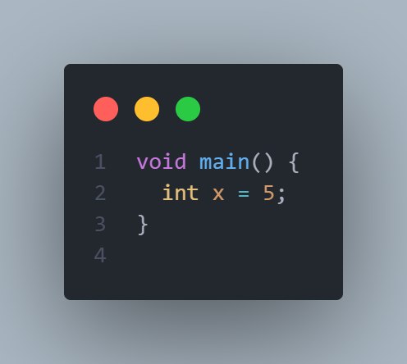
Operators
There are different kinds of operators, we already saw some from our previous slides and will
assignment operator
As the name suggests it assigns values to variables
We assign the value on the right to the variable on the
left

Slide 2
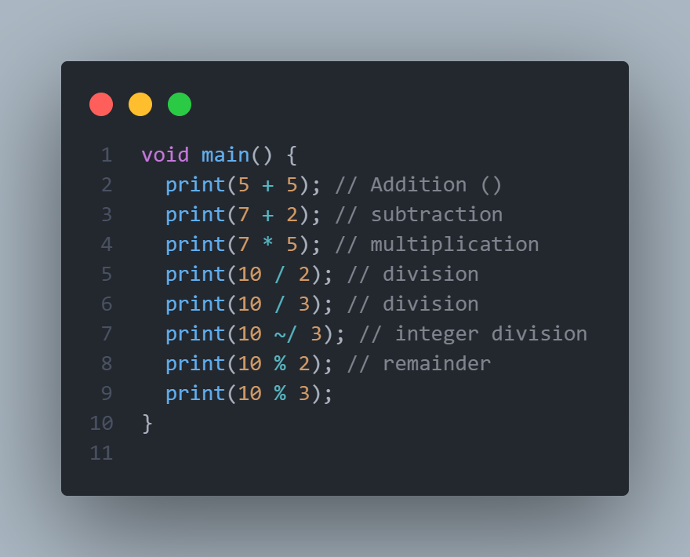
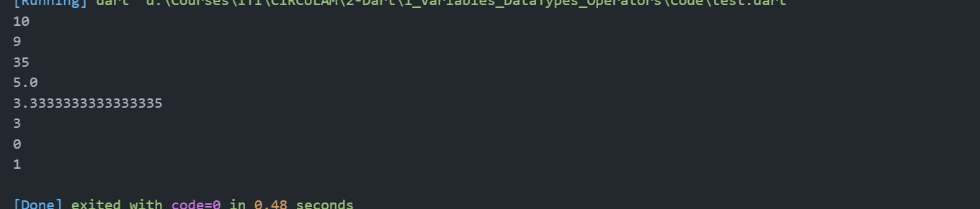
Operators
There are different kinds of operators, we already saw some from our previous slides and will
arithmetic operators
As the name suggests these are basic math operators, like addition(+) and subtraction(-)

Slide 3
Arithmetic operators continue
The integer divison as you can see outputs only the integer part
10 /3 =3.33333
10 ~/ 3 = 3
So we omit the decimal part
Modulars operator outputs the remainder of the division
An easy way to understand it is by an example
10 % 3 = 1
Why is the result = 1?
If I tell how can you reach 10 by adding only 3 without exceeding 10?
Ans 3+3+3 = 9
The remainder is 10 – 9 = 1
I needed to add one t

Slide 4
Operator precedence
Operator precedence is as you might expect in math class the division and multiplication are calculated first after the addition and subtraction, if we surround numbers with parnthess, these are calculated first
Eg:
1+5*2 =10+1 = 11
(1+5)*2 = 2*6 =12

Slide 5
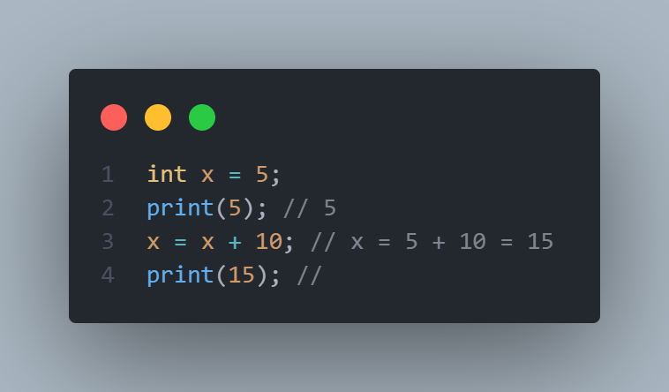
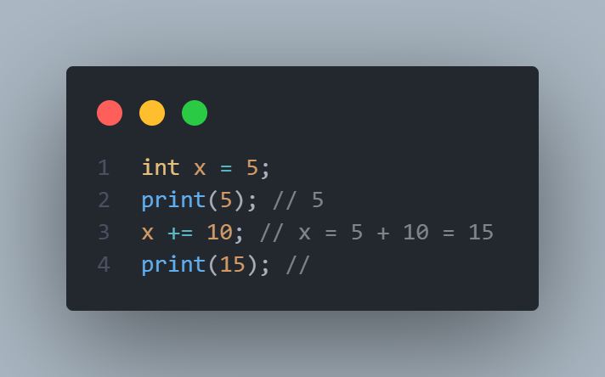
compound assignment operators
Some times we define a number then increment it after that we do the following
We define x with five in line 1 then we increment it
By 10 in line 3, but there is a shorthand way
To do so
Second picture shows a shorthand way to achieve the same result

Slide 6
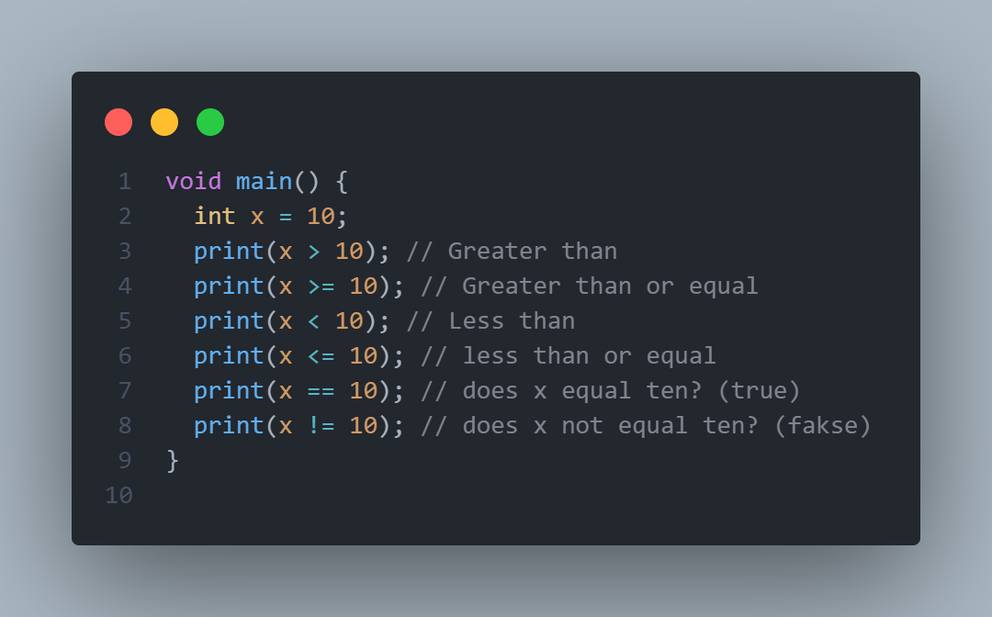
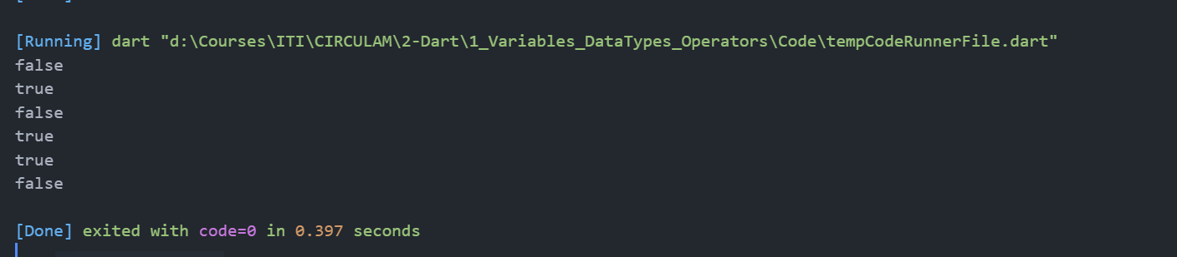
Comparison operators
These are you used to compare numbers and they are
<,<=,>,>=,==,!=
They produce only true or false based on the condition it’s like asking a question is the entered number greater than 10 if yes then the result is true, if no then the result is false

Slide 7
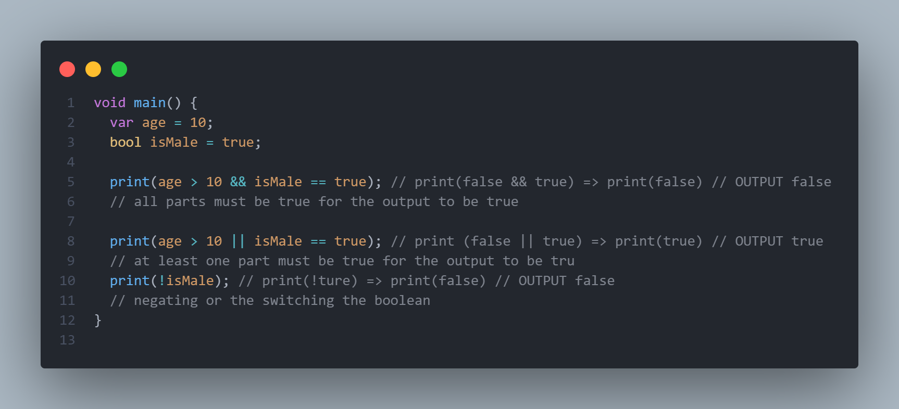
Logical operators
There are 3 operators in this category
&& AND =< outputs true only if all parts are true
|| OR Outputs true if at least one part of the equation is true
! Not =< Negates the condition if true, turn it into false and if false turn it into true

